Slide 1
Daddy’s Help Smart Baby Carer
Dumitrescu Diana
Pitaru Alexandra-Elena

Slide 2
Project description
Introducing our innovative Arduino-based Smart Baby Care System designed to provide an extra layer of care and convenience for both infants and parents.
This intelligent system integrates various sensors and automation mechanisms to monitor the baby's environment, ensuring optimal comfort and safety.
Our system offers crucial assistance for mothers and fathers who may be new to parenting or feel less confident in their caregiving skills.

Slide 3
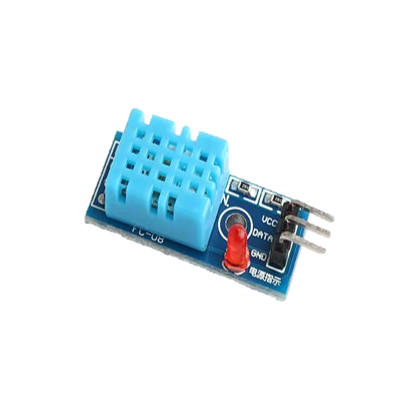
Key features:
01
Temperature and Humidity Monitoring:
The system employs precision sensors to continuously monitor the temperature and humidity levels in the baby's room.
If the temperature extends the predefined interval, a warning alert is triggered to notify parents, prompting them to take necessary actions to ensure the baby's comfort and well-being.

Slide 4
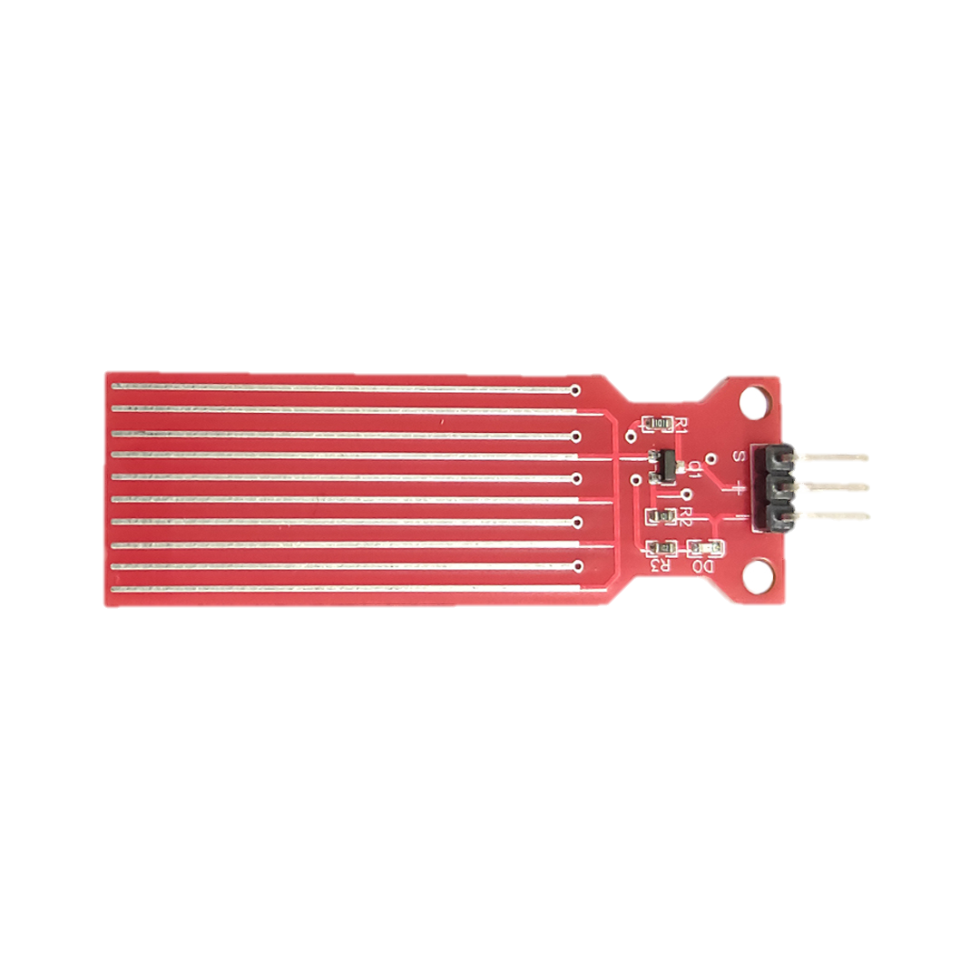
02
Diaper Wetness Detection:
A specialized water sensor discreetly placed in the baby's diaper actively monitors diaper wetness levels.
When the diaper reaches a critical wetness point, the system sends an alert, indicating that it's time for a diaper change. This feature helps maintain the baby's hygiene and comfort.

Slide 5
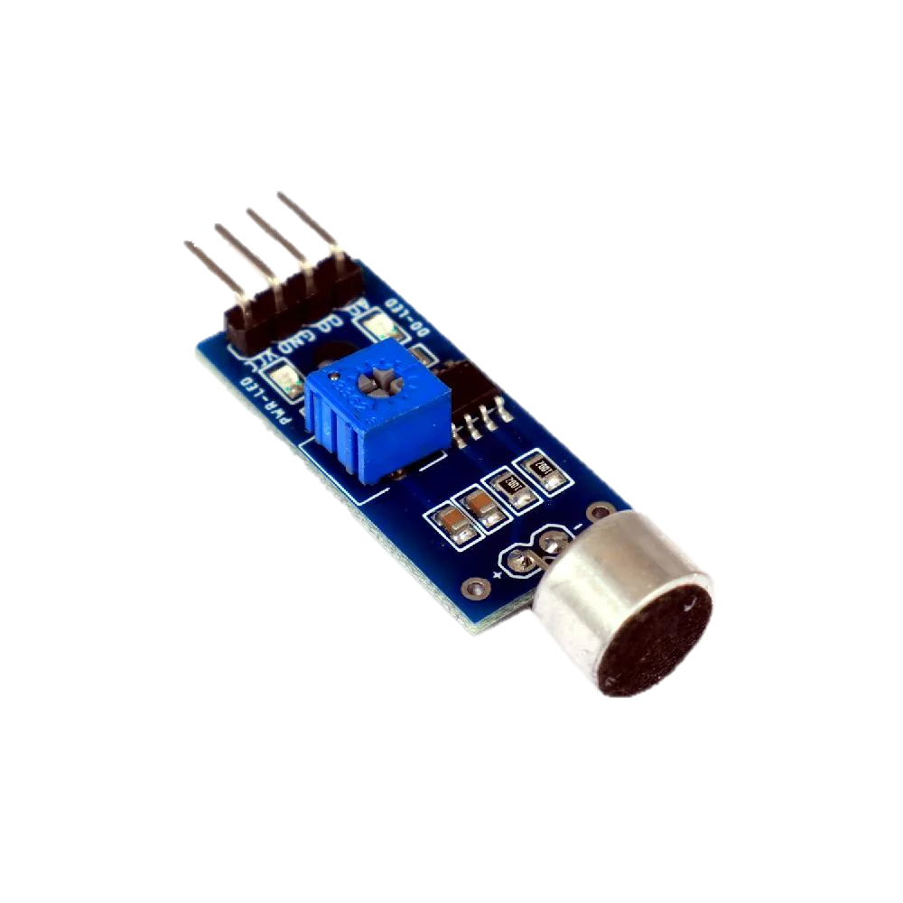
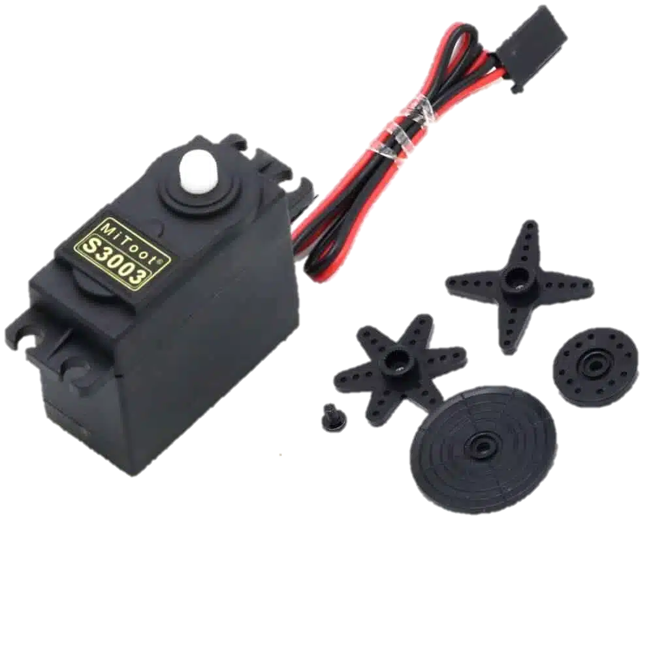

03
Sound Sensor for Crying Detection:
The built-in sound sensor accurately detects the sound of a baby crying.
Upon detecting crying sounds, the system activates a servo motor attached to the crib mobile. The mobile starts rotating gently, creating a soothing visual to calm the baby.

Slide 6
Future Developments

Slide 7
User-Friendly Interface:
The system will include an easy-to-use interface, possibly a mobile app, allowing parents to monitor real-time data and receive alerts conveniently.
The app would provide historical data trends, enabling parents to track changes in the baby's environment over time.

Slide 8
Integration with Health Monitoring Devices:
Incorporate compatibility with health monitoring devices to track the baby's vital signs, such as heart rate or sleep patterns.
This additional data could provide valuable insights for both parents and healthcare professionals.

Slide 9
Camera and Video Monitoring:
Include a camera system for video monitoring, allowing parents to check on their baby visually through the mobile app.
Ensure robust security features to protect the privacy of the family.

Slide 10
Thank you!

